Slide 1
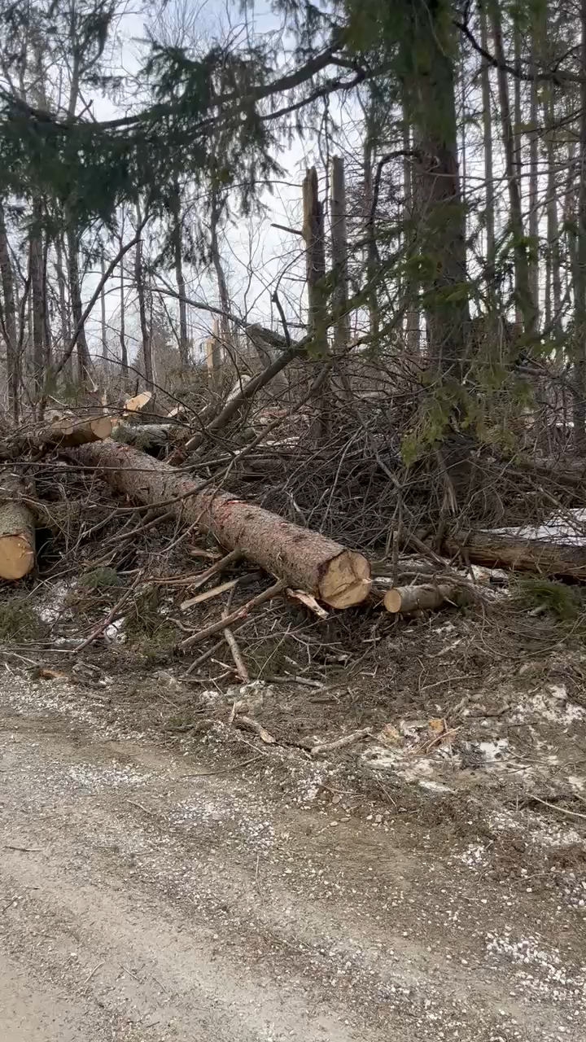

Exh. GMP-DM-KB-2
April 3-6, 2024 Storm Video
Video of April 4 Storm Damage.
Area has cable in conduit underground which was not impacted.
Press Play in PPT file to view video

