Slide 1
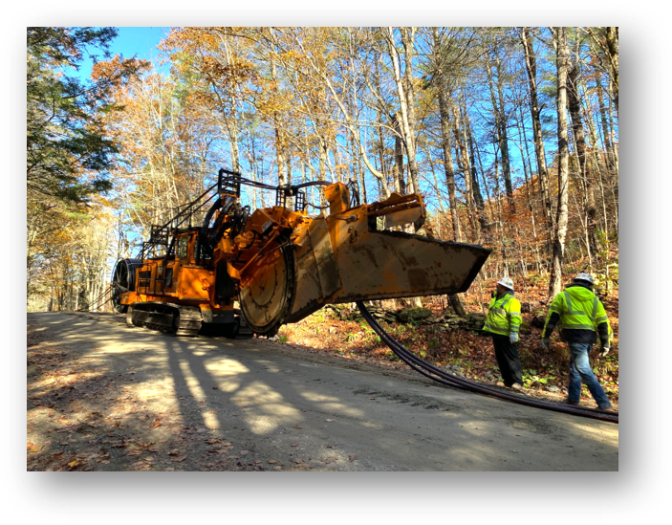

Exh. GMP-MB-16
Zero Outages Initiative – Undergrounding Equipment

Slide 2
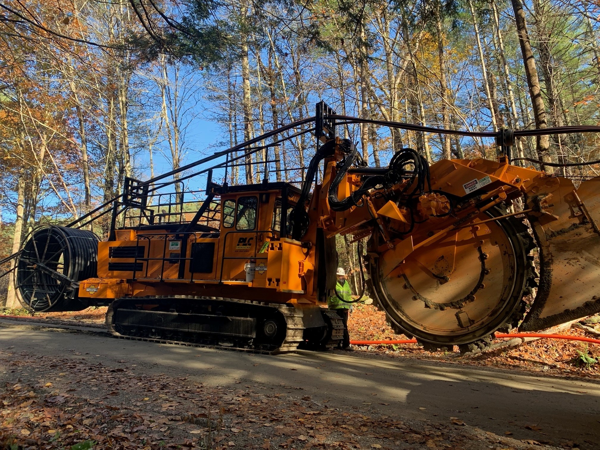
Zero Outages Initiative – Undergrounding Equipment

Slide 3
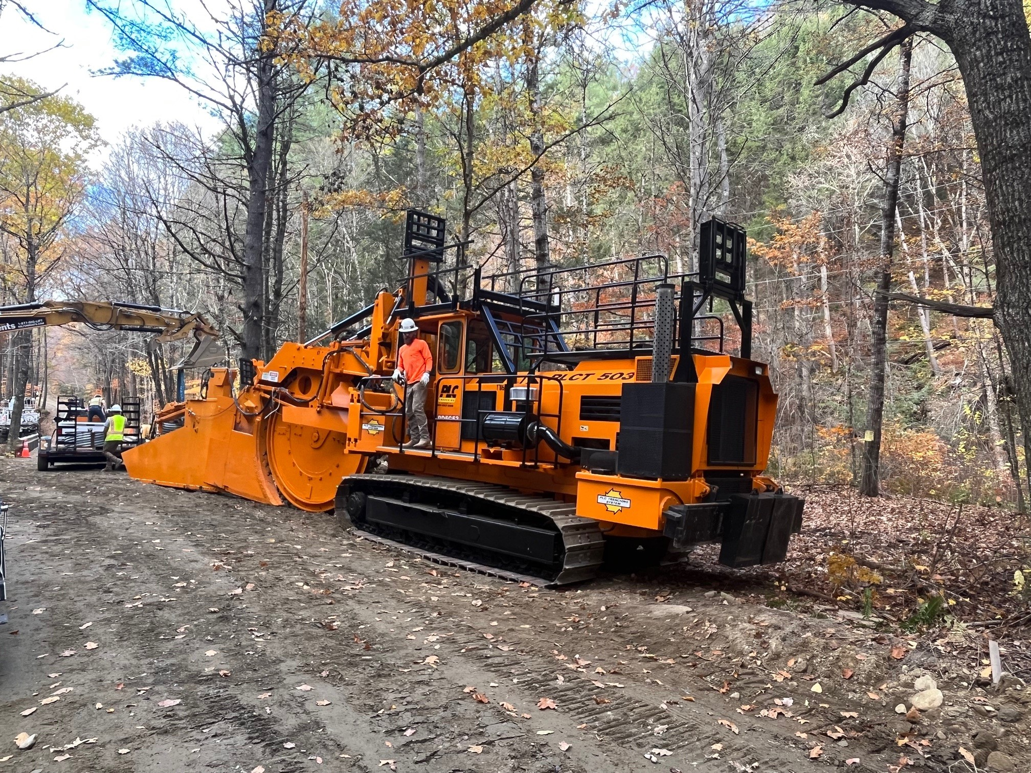
Zero Outages Initiative – Undergrounding Equipment

Slide 4
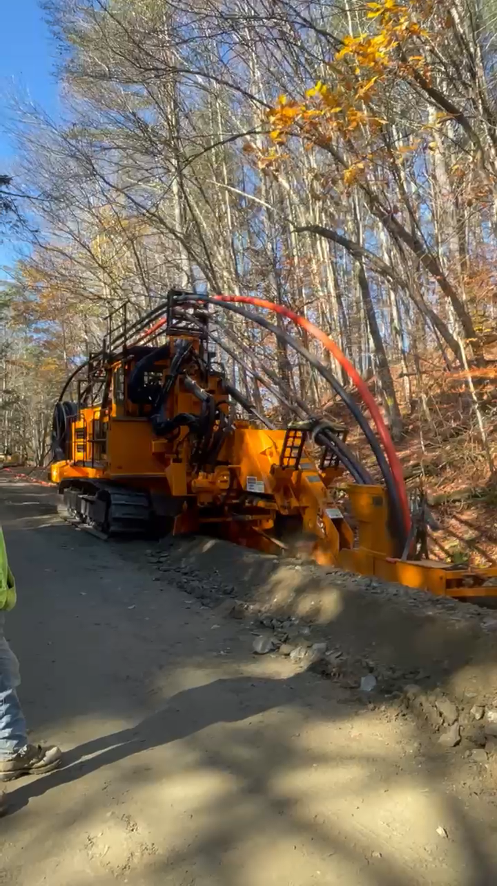
Zero Outages Initiative – Undergrounding Equipment
Press play for video in electronic PPT file

