Slide 1
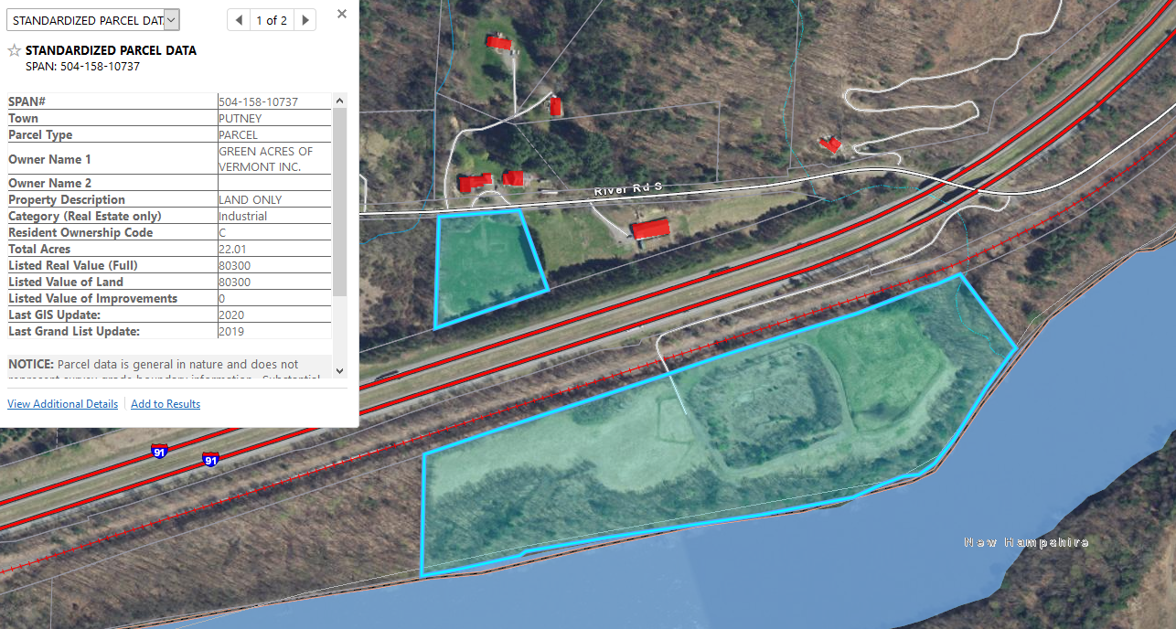
Putney, Windham Co.,
Vermont
1,300 foot +/- private access overlap on I-91 / CVP / NECR
undocumented farm crossing
NECR Palmer Sub – MP 131.26 +/-
GPS 42.968705, - 72.495341
50 feet
NECR / CVP railroad corridor
Putney Green Acres Solar LLC
Net metering site PUC # 20-3715-AN

Slide 2
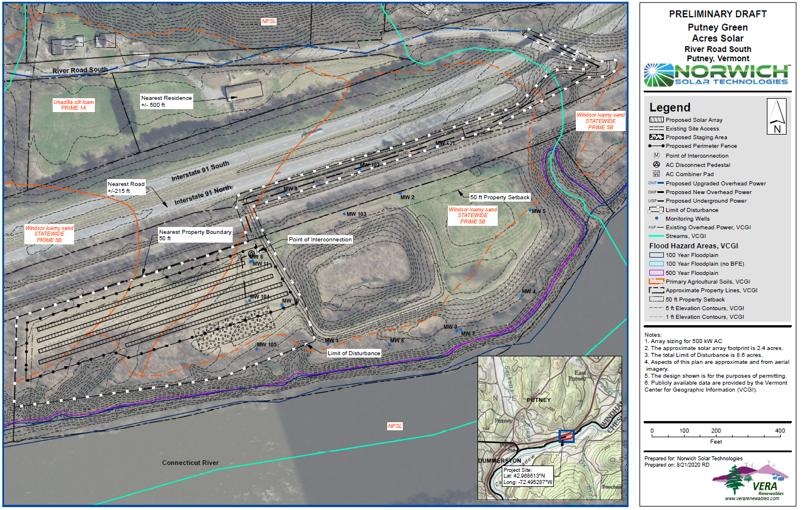
proposed crossing over & access along operating railroad

