Slide 1

Washington Electric Cooperative (WEC)
Rate Design Tariff Filing
Case No 19-1270-TF
July 31, 2019
Presented by
Patty Richards (WEC) &
Jason Strong (National Rural Utility Cooperative Finance Corporation)

Slide 2
Policy Considerations
Patty Richards, WEC General Manager

Slide 3
Existing Rates & Goals
Last Rate Design 2009
Designed to promote energy efficiency and discourage high use
Low monthly Member charge (currently $14.19 per month)
Two Tiered Energy Rate
First 200 kWh low block ($0.11350 per kWh)
Tail Block ($0.25341 per kWh)
Rate Design has been effective
Among lowest residential monthly average use in state

Slide 4
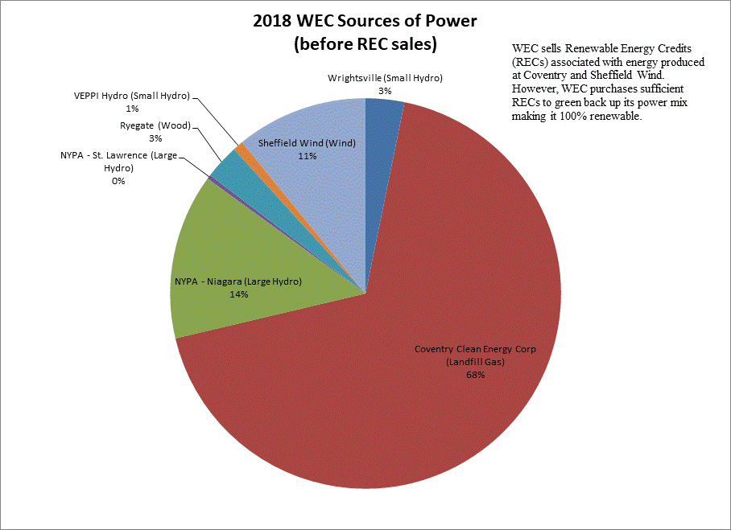
Proposed Rate Design Goals
Respond to Climate Change
  WEC 100% Renewable Power
Act 56 Renewable Energy Standard (RES)
  90% Renewable All Energy forms by 2050
  Tier 1, Tier 2 and Tier 3
Tier 3 (WEC’s Button Up)
  Encouraging members to switch from fossil fuel to renewable electric sources
To accomplish these goals WEC needs to lower the energy portion of its electric rates
Pairing lower energy rate with Tier 3 will help work toward achieving goals of State RES/Act 56
Maintain low block of 100 kWh and lower rate to encourage energy efficiency

Slide 5
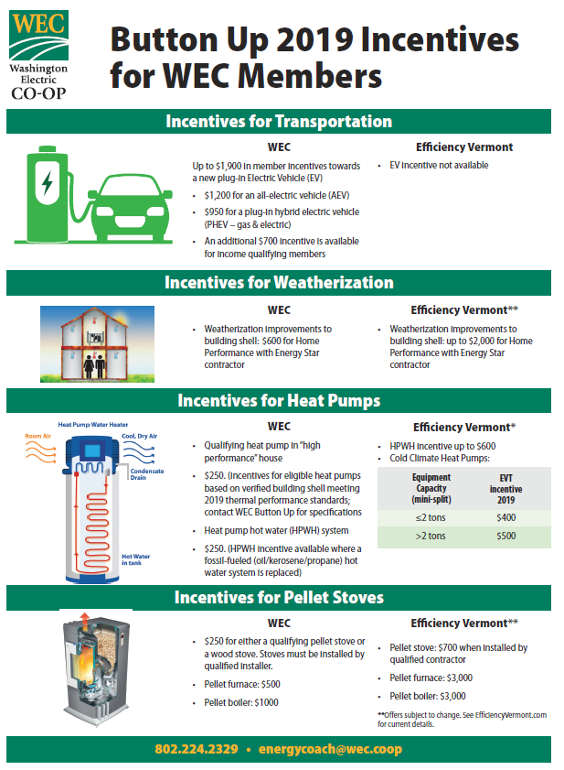

WEC Button Up - Tier 3

Slide 6
Member Demographics

Slide 7
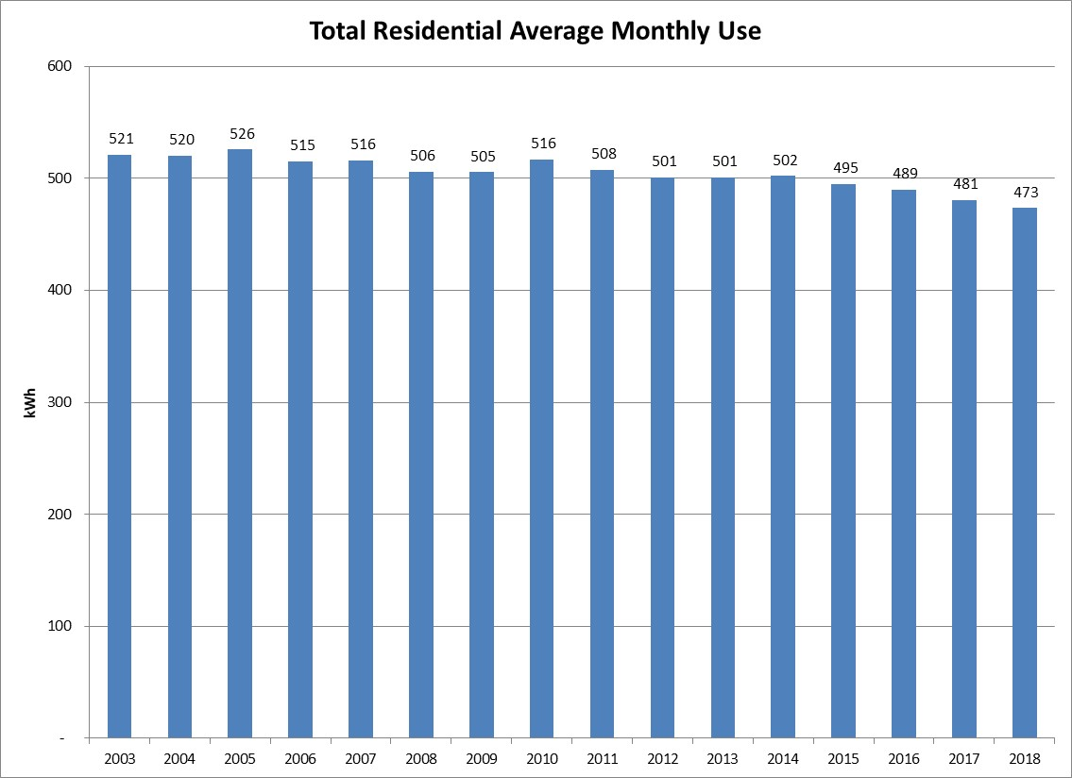
Average Residential Member Use
(13% Less Than State Avg Use)

Slide 8
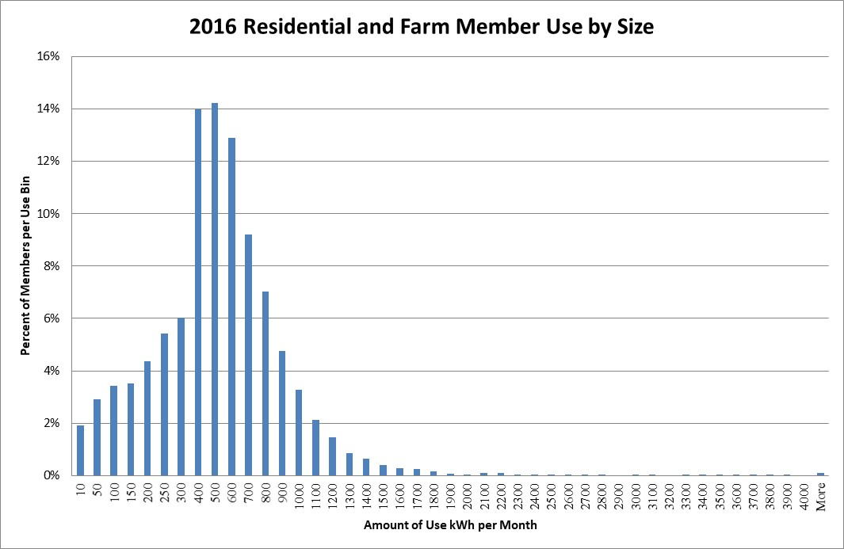
Residential Member Demographics

Slide 9
What are the proposed rates…

Slide 10
Dollar Impact Based on Use Residential Class

Slide 11
Member Outreach
Membership Meeting September 19, 2018
12 members attended
All self selected
All low users (less than 400 kWh)
Written Communications
Coop Currents Newsletter
June 2017 – January 2019 published 20 Articles on Rate Design
Bill Messages
Board of Directors
Nine member Board of Directors
Deliberated for 2 years
Focus Group November 4, 2017
Very Informative
Significant contributor of feedback

Slide 12

Focus Group
November 4, 2017
Representative Sample
    Usage: High, Medium, Low
    Income Diversity
    Township Diversity
Called 620 members and solicited participation
19 Participated
8:30 to 12:30 in Montpelier
Presentation of the issues and rate design options WEC considering
Broken into three separate groups
Option 1, Status Quo - Rates at the time of the presentation: $12.97 monthly charge, up to 200 kWh @ $0.10373/kWh, and greater than 200 kWh at $0.23160/kWh
Option 2, $25 monthly charge, and all energy use charged at $0.16140/kWh (removal of inclining rate structure and one energy rate for all energy use)
Option 3, $25 monthly charge, up to 100 kWh @ $0.09961/kWh, and greater than 100 kWh at $0.17511/kWh

Slide 13
Focus Group Results
  All groups
    Valued conservation/efficiency
    Wanted to keep some element of a low block at a reduced rate;
    Valued being WEC members and being part of the rate design process;
    Valued fairness to all WEC members;
  Options 1 and 3 were most popular:
    OPTION 1, Status Quo, $12.97 monthly charge, 200 kWh at $0.10373/kWh, and above 200 kWh at $0.23160/kWh (rates at time of focus group)
    OPTION 3, $25 monthly charge, 100 kWh at $0.09961/kWh, and above 100 kWh at $0.17511/kWh
  No one voted for Option 2 (one energy rate)
    All groups wanted to keep the two-tiered inclining rate system
  Significant agreement that current monthly customer charge was too low

Slide 14
Rate Design Structure Selected by WEC Board of Directors
Set Monthly Customer charge $25 (28% of full fixed costs)
Retained low cost energy block but reduced to 100 kWh and set rate to $0.08 per kWh (lower than current low block)
Tail Block Energy rate calculated to recover remaining costs ($0.19961 residential rate)

Slide 15
Analysis
Jason Strong, NRUCFC

Slide 16
Cost of Service & Rate Design Process
Completed a fully allocated, embedded cost of service study
Employed methods, practices and procedures consistent with the Federal Energy Regulatory Commission (FERC) and National Association of Regulatory Utility Commissioners (NARUC) prescribed processes and manuals
  Cost of service study model previously filed and accepted by Vermont Public Utility Commission (PUC)
  Supports WEC’s proposed rate design proposal (customer charge level)
Cost of service study aligns with WEC’s recent rate increase filing of 5.49% approved in PUC Case No. 18-3959-TF
  All costs were from WEC’s billing and accounting system for the year September 1, 2017 through August 31, 2018
  Used Adjusted Rate Year ending December 31, 2019 as established by WEC in Case No. 18-3959-TF
Proposed rate design is revenue neutral
Details provided in Prefiled Direct Testimony of Jason A. Strong and supporting Exhibits

Slide 17
Cost of Service Study Steps
Functionalization
  Dividing rate base and operating expenses into functional categories
  Defined by FERC/Rural Utility Services (RUS) Uniform System of Accounts
    Generation
    Transmission
    Distribution
Classification
  Process of assigning functionalized costs into customer-related, demand-related and energy-related components
Allocation
  Apportion the functionalized and classified costs to the particular customer classes based on cost causation
  Utilized allocation methods consistent with FERC and NARUC manuals

Slide 18
Cost of Service Study Results
Each class of customer was close to recovering their cost of service (except for Large Power)
WEC is not proposing to make changes to the class revenue levels (revenue neutral)

Slide 19
Cost of Service Study Cost-Based Rates
Results indicate that fixed costs, particularly customer-related, could be higher than what is recovered through currently effective tariff rates

Slide 20
Residential Results
Cost of service study supports higher customer charge
WEC has large amount of fixed costs that don’t fluctuate with energy usage
Straight-Fixed
  Fixed costs $89.67 per member/month
  Energy $0.04025
    Fuel & variable O&M
Proposed customer charge of $25 per month is 28% of straight-fixed costs

Slide 21
Misaligned Cost Recovery
WEC’s current rates configured with high percentage of revenue recovery through volumetric energy charge
  Contributes to more frequent rate increases
Cost recovery and cost causation alignment keep rates equitable and avoids distortion
WEC proposal is a gradual movement toward correcting imbalance of causation and recovery
WEC proposal balances cost recovery and cost causation

Slide 22
Thank You
Questions?

