Slide 1

Non-Traditional Regulation:
A Survey
12 SEPTEMBER 2017
Vermont Public Utility Commission
Notes:
I’ll apologize in advance for this presentation, by paraphrasing Blaise Pascal: I’m sorry that this presentation is so long; I didn’t have time to prepare a shorter one.
There are too many words. I’ll leave the reading to you. I’ll just touch on key points.

Slide 2
Stage-Setting: The Challenge
1
Aligning the private interest with the public interest

Slide 3
“All regulation is incentive regulation.”*
The trick is to understand how the incentives work
*Bradford, P. (1989). “Incentive Regulation from a State Commission Perspective.” Remarks to the Chief Executive’s Forum.

Slide 4
Traditional Regulation: a price-setting exercise only
A rate case produces a “revenue requirement”, which is then divided by sales (billing determinants) to determine prices
The actual revenue a utility receives is a function of sales
  Revenue = Sales * price
Two powerful incentives:
  To reduce costs
  To increase sales, even when societally uneconomic (because marginal cost is almost always less than average cost, esp. for network delivery service)
    This is the “throughput” incentive

Slide 5
Tackling the Throughput Incentive: Revenue Regulation
Revenue regulation (or “decoupling”):
  Breaks the link between sales and revenues
    This is about revenues, not earnings
      An important program design distinction
  One incentive now: reduce costs
    Lower costs = higher net income
  Indifference to sales levels, lower or higher
    Whatever the cause: weather, economic factors, programmatic EE, other DER, etc.

Slide 6
Driving Preferred Outcomes: Performance Incentive Mechanisms
Financial rewards and penalties (PIMs) associated with the achievement of specified outputs and outcomes
  Generally agnostic to means of achievement
Typically overlaid on revenue-based regulatory regimes
  The rewards and penalties affect total “allowed” (or “target” or “authorized”) revenues

Slide 7
Some Performance Metrics
Reliability
Customer service
Power plant performance
Safety
Energy efficiency
Environmental achievements
Other?
Notes:
Like a report card on key subjects

Slide 8
Revenue Regulation and PIMs: the Structural Elements of PBR
How is the utility business model changing?
  Drivers?
  Disruptive technology?
  Empowered customers?
Can PBR be structured to harness disruption while providing utilities with flexibility to achieve the measurable performance criteria?
How can the private interest be best aligned with the public?
Notes:
A brief thought or two on this at the end.

Slide 9
Examples of Performance-Based Regulatory Regimes
Domestic and International

Slide 10
United Kingdom: RIIO
October 2010: Ofgem (UK regulator) introduced new regulatory framework for energy network companies: gas, electric distribution, & electric transmission
RIIO: Revenues = Incentives + Innovation + Outputs
  Implemented in 2013
  Replaced 23 years of RPI-X revenue-based regulation
RIIO is also a revenue-based regulatory model
Overlaid with an incentive-based framework for achievement of specified outcomes
  Performance in creating a sustainable energy sector and delivering long-term value for money network services
  Those that deliver outputs, innovation, and associated lower costs have the potential to earn above normal returns and those that don’t deliver earn below normal returns.
Notes:
In the UK and Europe generally, the vocabulary of revenue regulation is “price controls”. Don’t let it confuse you.

Slide 11
UK: RIIO
RIIO is intended to remove any bias favoring capital expenditures (CAPEX) over operational expenditures (OPEX)
  Referred to as “TOTEX” (total expenditures)
Focus is on outputs rather than simply new infrastructure
Extension of revenue-control term from 5 years to 8
  Recognition of the long-term nature of the investments necessary for a low-carbon transition.

Slide 12
UK: RIIO
Outputs relate to:
  customer satisfaction;
  network safety;
  network reliability;
  new connections;
  environmental impacts; and
  social obligations

Slide 13
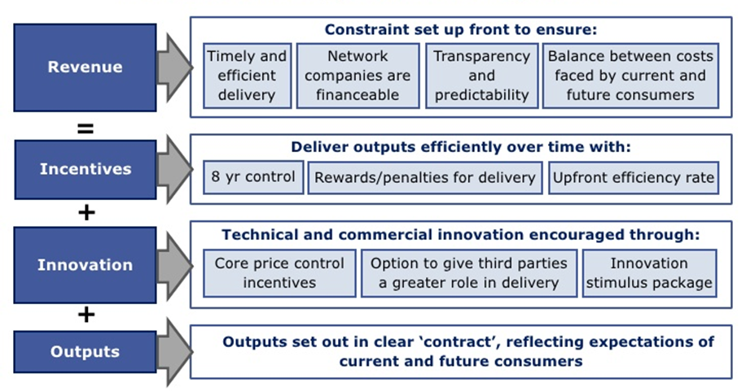
UK: RIIO

Slide 14
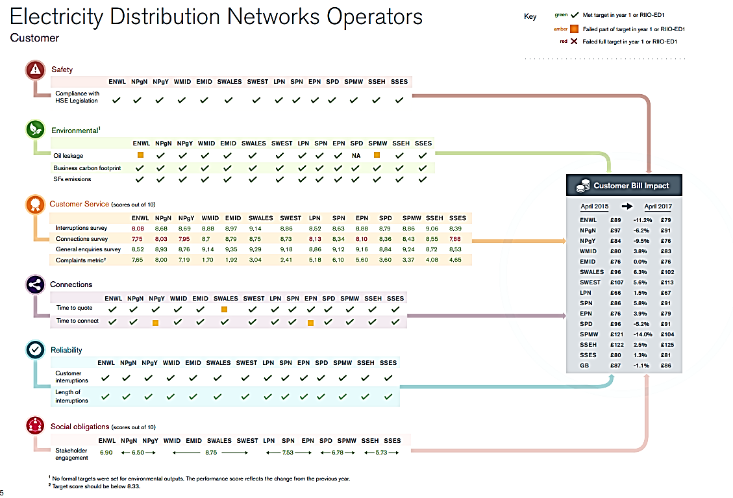
RIIO: Metrics

Slide 15
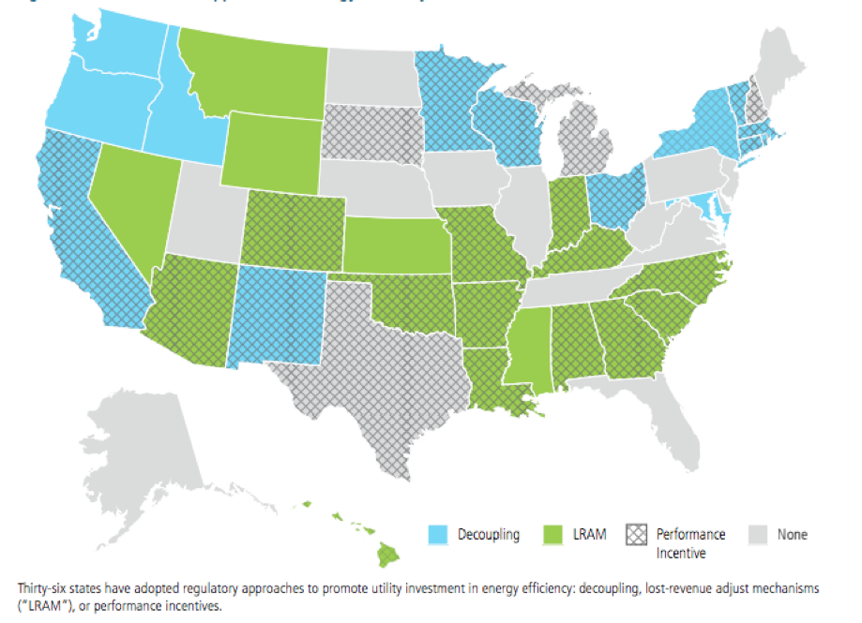
PBR: Revenue Regulation and PIMs in the US
Notes:
There’s a correlation between the states with blue, and esp, blue and cross-hatching, and EE performance.

Slide 16
California: Pacific Gas & Electric
Revenue regulation of network services:
  Non–weather-adjusted actual revenues compared with authorized (“target”) revenues plus annual attrition (and exogenous, e.g., tax) adjustments
    Over- or under-collections trued-up annually
  Authorized revenues, based on future test year, established through a general rate case every 3 years
    Authorized revenues are also established for the two years following the future test year.
  Annual “attrition case” measures changes in costs and adjusts authorized revenue
Notes:
The authorized revenues are based on a weather-normalized test year (same in all jurisdictions). Non-weather-adjusted revenues means simply the actual revenues in the period.

Slide 17
California: Pacific Gas & Electric
Revenue regulation of network services (cont’d):
  Collected revenue tracked through five balancing accounts:
    Distribution Revenue Adjustment Mechanism
    Public Purpose Program Revenue Adjustment
    Nuclear Decommissioning Adjustment Mechanism
    Utility Generation Balancing Account
    Regulatory Asset Revenue Adjustment Mechanism
  Surpluses/deficits amortized and refunded/collected in the next year
  Applies collectively to all customer classes
    Not reconciled by individual class or balancing account
Energy procurement and FERC-regulated transmission service treated separately
PIMs for EE
  Rewards (or penalties) for achievement (or not) of savings targets

Slide 18
Idaho: Idaho Power Company
IPC’s Fixed Cost Adjustment (FCA) mechanism compares authorized network revenue with weather-normalized sales
  Annual reconciliation
  Applies to residential and small business customers only
  Company retains weather risk
    Which means that customers retain the risk too
  Authorized revenue adjusted by number of customers
    I.e., rate case revenue requirement divided by # customers = RPC (average “revenue per customer)
    RPC * actual # customers = authorized revenue_{t+1}
Notes:
Large customer classes are deemed to be too small and too various in customer load characteristics to be amenable to the decoupling mechanism. The potential swings in prices (adjustments) are feared to be too large.
Unlike in California and other states, Idaho calculates actual revenues as if it were a weather-normal year. That means that the difference between actual and authorized revenues doesn’t account for revenue gains or losses due to weather deviations. IPC retains that risk. In other words, in cold winter/hot summer years, it makes more money and in warm winter/cool summer years it makes less money. So some measure of the throughput incentive remains.

Slide 19
Idaho: Idaho Power Company
FCA (cont’d):
  Annual adjustments shared proportionately by residential and small commercial customers
Energy costs recovered through fuel adjustment clause
IPC is required to acquire all cost-effective EE
  However, no performance incentives/penalties
No other PIMs

Slide 20
Maryland: Baltimore Gas & Electric
Revenue regulation mechanism compares actual distribution revenue to the authorized revenue, adjusted for the number of customers (revenue-per-customer, or RPC, approach), for each applicable rate schedule
  Authorized revenue based on test year requirements and sales levels
  Over- or under-collections are reconciled monthly
    Adder/discount to base rates
    No deferred true-ups

Slide 21
Maryland: Baltimore Gas & Electric
Multi-year plan but no formulaic adjustments (other than RPC) in authorized revenues
Changes in base rates through rate cases
Power costs dealt with through fuel adjustment clause
No PIMs for EE or other public policy objectives (yet)

Slide 22
Wisconsin: Wisconsin Public Service Company
WPS Revenue Stabilization Mechanism (RSM) reconciles target marginal revenue per customer with actual marginal revenue per customer
Authorized revenues established in rate case (future test year)
  No annual adjustments for inflation, productivity, Z (exogenous), or K (special) factors
Applies to all tariffs except large commercial and industrial
Fuel costs recovered separately through an FAC
Notes:
Not exactly sure why it talks about “marginal” revenue, except that it seems to refer to the difference between actual and authorized revenue.

Slide 23
Wisconsin: Wisconsin Public Service Company
RSM = total revenue for each tariff, excluding fuel costs, surcharges, credits, taxes, etc.
  Forecasted rate year for authorized revenue
  Described as “margin” because the recovery mechanism is a surcharge/credit on energy prices
    Surcharges subject to hearing before going into effect
    $14 million cap on total revenue change (+/-) from year to year. Overages borne by WPS.
No EE PIMs for WPS (but there are for other WI utilities)

Slide 24
Massachusetts: National Grid
Revenue regulation mechanism for National Grid compares authorized distribution revenue to actual distribution revenue
  Annual adjustments in prices to collect authorized revenue
  Adjustments made by customer class
  Adjusted also for changes in distribution capital expenditures
    Adjusted each year to account for actual capital expenditures in the previous year, net of depreciation expense in base rates
    This “K” factor adjustment intended to reduce bias favoring CapEx over cost-effective OpEx
    Capital expenditures subject to prudence review and capped at $170 million/year

Slide 25
Massachusetts: National Grid
Energy costs for basic service customers, transmission costs, EE costs, and low-income assistance treated separately
Authorized revenue also adjusted for 50% sharing of earnings in excess of allowed ROE
Increases in allowed revenue capped at 3%/yr
  Interim adjustments possible if deviation looks to exceed 10%
PIMs for
  Meeting EE savings targets (up to 5% of program costs)
  Meeting service quality standards

Slide 26
Hawaii: Hawaiian Electric Co.
Revenue regulation mechanism that compares actual distribution revenue to target revenue in each year
  Target revenue is the authorized revenue for the last test year, adjusted for changes in O&M and rate base (i.e., annual attrition adjustments, à la PG&E)
    Labor O&M adjusted for productivity
    Non-Labor O&M adjusted according to cost index
    Rate base adjusted for changes in plant-in-service, accumulated depreciation, contributions in aid of construction, & accumulated deferred income taxes
Separate mechanisms for power and EE costs

Slide 27
Hawaii: Hawaiian Electric Co.
Earnings Sharing Revenue Credit mechanism
  To protect against excessive overall revenue collections
  Sliding scale up to 90% customer share after 300 basis point change (+/-) in ROE
Provisions for “K” factor adjustments related to capital investment (if beyond expectations) and other mid-course corrections
EE provided by a third-party administrator, which is compensated according to performance
No other PIMs, but the PUC is investigating incentives for superior performance in achieving the state’s clean energy objectives while meeting minimum reliability standards

Slide 28
China: T&D Revenue Regulation with PIMs
State-owned enterprises:
  T&D (“gridcos”) are separate from generation
  By 2020, generation subject to wholesale competition; some direct access retail competition already in effect
Central regulator decreed that T&D be regulated on an “allowed revenue” basis, to be rolled out nationally in 2017
  To increase incentives for gridco operational efficiency
  Provincial pilots are developing outcome-specific PIMs for the gridcos, as overlays on the revenue regulation framework

Slide 29
China: T&D Revenue Regulation with PIMs
PIMs:
  Profitability and environmental performance have long been management performance criteria
  New PIMs will include capital usage, reliability, service quality, EE/DSM, or other criteria such as “innovation”
  Cost and investment controls and incentives:
    Operations and maintenance expenses benchmarked and capped
    Capital investments reviewed and set separately, to forestall investment that doesn’t serve load growth or reliability
    Productivity and reduced investment savings accrued during the 3-year regulatory period shared with customers

Slide 30
New York
Reforming the Energy Vision
Scorecard Metrics
  On-going task force looking at this
Earnings Adjustment Mechanisms
  Peak reduction and system efficiency
  Energy efficiency
  Interconnection
  Customer engagement and information access
  Affordability (scorecard for now)
  GHG reduction?
Notes:
Performance is an essential part of the architecture of the Reforming the Energy Vision movement.
They have had some administrative reporting, and are broadening the scope of metrics that will reporting, now in a public scorecard, in a collaborative way.
The financial incentives are delivered through Earnings Adjustment Mechanisms -- the commission has identified these areas and ordered proposals from utilities (not clear just how these adjustments will be made—whether as revenue adjustments or earnings adjustments)

Slide 31
Noted
Revenue regulatory schemes are invariably applied only to the network portion of a utility’s business (or network and other specified capital investment)
  That is, that component whose costs are largely fixed in the short run and don’t vary with changes in usage
Power costs (if a utility is also a provider of power) are typically handled separately, often with a system of rewards and penalties that create strong incentives to manage those costs wisely

Slide 32
PBR: Some Design Considerations
Timing of revenue adjustments
Cost of money: rates applied to deferred accounts
  Short-term debt rate, WACC, other?
Caps on revenue/price impacts?
Test Year: adjusted historic or future?
Length of plan before full rate investigation
Revenue adjustment mechanisms
  Inflation, productivity, # customers, separate treatment of specified costs
Allocation of deficits/surpluses
  System-wide, by tariff or customer class, or. . .?
Performance metrics?
  What is the public interest and how is it advanced?

Slide 33
Some New Challenges
3
PBR and Beneficial Electrification

Slide 34
Beneficial Electrification
Electrification: applying electricity to end-uses that would otherwise be powered by fossil fuels
Beneficial electrification:
  Reduces costs in the long term
  Reduces environmental impacts
  Enables better grid management
New York’s Reforming the Energy Vision (REV) process looks at these questions.

Slide 35


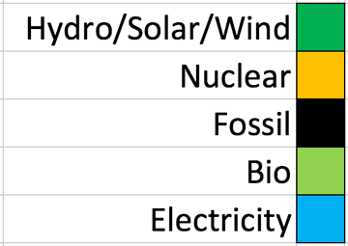


Opportunity Knocks
Opportunity Knocks for
Beneficial Electrification
“Fewer Joules, More kWh”
2015
25%
2050
53%
Source: Vermont Comprehensive Energy Plan 2016

Slide 36
Measuring Beneficial Electrification: A PBR Metric?
Distinguish from energy efficiency (EE), which is crucial but different
EE goal: Use fewer kWh to do a task
BE goal: Use fewer joules – by using more kWh
Emissions efficiency (“Emiciency”) = Total CO₂ emitted by a project vs. alternatives
Is this another way to look at the Tier 3 question? How might a PBR plan be structured to advance this and other objectives?
Notes:
This is still a new field, so good, concrete universal metrics haven’t evolved. But we’ve started to do so.
First, it’s important to understand that beneficial electrification is different from energy efficiency.
Energy efficiency means using fewer kWh to do a task. That’s a good thing.
Beneficial electrification often means using fewer joules – across all fuel types – but often means using more kilowatt-hours of electricity.
So instead of thinking solely in terms of “energy efficiency” – using fewer kWh – we need a different metric. NRECA and RAP think a good metric is “emissions efficiency” and we have coined the term “Emiciency” to reflect how much CO2 is emitted by the project, versus alternatives.

Slide 37
Conclusion
4
A Few Observations

Slide 38
Some Observations
Revenue regulation is shown in multiple jurisdictions to provide cost containment incentives to utilities
  PIMs, esp. when overlaid on revenue regulation, can drive achievement specified outcomes
Beware consequences of features intended to limit downside risks to consumers, as they also can limit the upside by diluting incentives for operational efficiency, cost containment, and innovation, e.g.:
  Earnings sharing mechanisms
  Separate cost/investment trackers
Revenue regulation reduces/eliminates revenue risks associated with more economically efficient rate structures
Public education and design processes are elements of successful non-traditional regulatory regimes
LRAMs don’t solve the “throughput” problem
Notes:
Earnings sharing mechanisms, depending on how they’re designed, also break the link between costs and net income.

Slide 39
A plea

