Slide 1
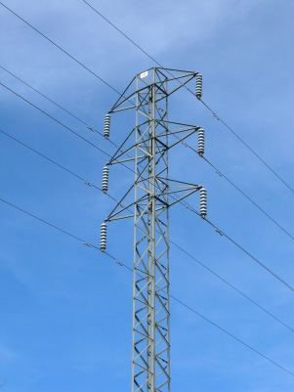
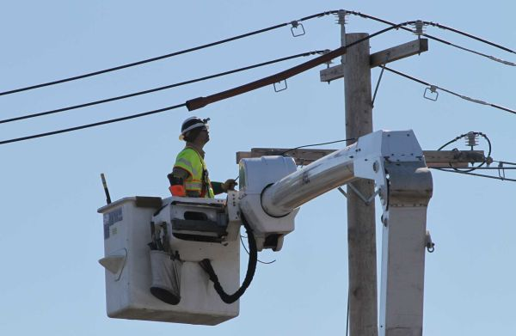

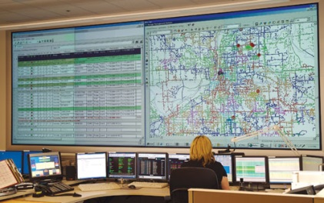
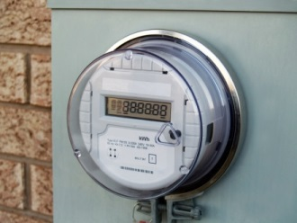
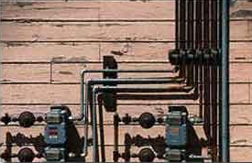

Analysis of Vermont Alternative Regulation
David E. Dismukes, Ph.D.
Center for Energy Studies
Louisiana State University
January 22, 2015
Disclosure: Financial support for this report provided by AARP.

Slide 2
Executive Summary
Executive Summary – Traditional Regulation
Utilities are regulated because they are natural monopolies and provide services imbued with the public interest.
In competitive markets, prices are set at costs. Regulators also seek to emulate some aspects of competitive markets by setting rates equal to costs. In competitive markets, efficient firms are profitable, inefficient firms go out of business.
Traditional regulation is data-intensive and relies heavily on information transparency and incentives. Rate cases are the primary means by which regulators attain information about their regulated firms’ costs.
Regulatory lag is the primary incentive mechanism associated with traditional regulation. Regulatory lag represents the time period between when a utility’s rates are set and their next rate change request.
Rates are set on costs and are fixed in the time period between rate cases: if a utility can increase efficiencies between rate cases it can increase its earnings and profitability and vice versa, just like competitive markets.
New Natural Gas End Uses & Fuel Diversity Concerns
© LSU Center for Energy Studies

Slide 3
Executive Summary
Executive Summary – Challenges to Traditional Regulation
Alternative regulation arose to (1) address the informational asymmetries between regulators and regulated firms that can often lead to capital investment inefficiencies (i.e., “gold plating”) and (2) to institutionalize “regulatory lag” by making it an active (rather than passive) means of promoting efficient utility performance.
A commonly-recognized aspect of most types of regulation is that regulators typically have less information than regulated companies about the true cost and nature of providing service (i.e., “asymmetric information”). The over-capitalization experience of the nuclear power plant development period for electric utilities is a good example of this problem.
In addition, under traditional regulation, a utility’s ability to maximize its efficiency opportunities within regulatory lag can be potentially constrained if a regulator pulls the utility in for a rate case and effectively “expropriates” the excess earnings generated by efficiency investments.
Alternative regulation is a process that seeks, in part, to minimize these two traditional regulation deficiencies.
New Natural Gas End Uses & Fuel Diversity Concerns
© LSU Center for Energy Studies

Slide 4
Executive Summary
Executive Summary – Alternative Regulation
New Natural Gas End Uses & Fuel Diversity Concerns
Alternative regulation is a modification of, not a substitute for, traditional regulation. This modification seeks to de-emphasize (but not eliminate) the role of rate cases in determining actual utility costs and rates. Alternative regulation typically defines a fixed time period (or program “term”) in which rate cases are avoided in preference of an alternative method of adjusting utility rates.
Alternative regulation uses a formula-based approach for changing rates during the program’s term. The rates utilized at the beginning of the program term, however, are still set by a traditional regulatory process. It is the process by which rates are allowed to change between rate cases that differs from the traditional approach.
Alternative regulation uses an earnings sharing mechanism (“ESM”) to define the manner in which efficiency-created excess earnings will be shared between shareholders and ratepayers (i.e., institutionalizes or codifies regulatory lag).
Thus, alternative regulation takes a little of the “old” (cost of service ratemaking and regulatory lag) to combine with a little of the “new” (formulaic increases in rates and fixed regulatory review periods) to increase the effectiveness of the utility regulatory process for both parties (utilities and ratepayers).
© LSU Center for Energy Studies

Slide 5
Executive Summary
Executive Summary – Vermont Experience
Vermont’s two alternative regulation plans (Vermont Gas Systems, Green Mountain Power) have common components that include a fixed term, a formula-based plan for adjusting rates, and an earnings sharing mechanism. There are, however, two important problems with the current Vermont alternative regulation plans.
First, the sharing of risks and rewards within both plans’ various components is not balanced and is skewed in favor of the utilities. For instance, the rate adjustment formula for both plans give generous rate adjustments and utilize very small consumer dividend offsets (as represented by what is called the “productivity offset adjustment”) that might condition the degree to which rates can increase in any given year.
Second, and more importantly, both plans allow utilities to include large capital investments to be entered into rates on a dollar-for-dollar basis with little regulatory accountability (as reflected in the lack of annual reporting requirements). The GMP alternative regulation plan, however, was recently modified to address this deficiency.
New Natural Gas End Uses & Fuel Diversity Concerns
© LSU Center for Energy Studies

Slide 6
Recommendations
Summary of Recommendations
Require the Board to open a proceeding to reconcile alternative regulation plans between VGS and GMP with the goal of creating program consistency that balances the risks between utilities and ratepayers.
Limit the use of capital expenditure cost recovery mechanisms within the plans:
  No capex mechanisms allowed until project-specific and financial need is proven.
  If major capital program costs are allowed, utilities must be required to provide a detailed set of minimum filing requirements for annual reconciliations (similar to the recent GMP settlement agreement).
  If major capital program costs are allowed, utilities must include performance-based measures with penalties for non-performance.
  If capital program costs are allowed, they must be subjected to ratepayer protection mechanisms that include, but are not limited to, total annual investment caps, rate impact caps, minimum filing requirements, and performance benchmarks with penalties for non-compliance.
Consider additional modifications to make the Department more consumer advocacy-oriented.
New Natural Gas End Uses & Fuel Diversity Concerns
© LSU Center for Energy Studies

Slide 7

Center for Energy Studies
Traditional Regulation
© LSU Center for Energy Studies

Slide 8
Monopoly
Traditional Regulation
Traditional Regulation
Center for Energy Studies
Why Are Utilities Regulated?
Utilities are regulated for two reasons:
  Utilities are imbued with the public interest: utilities provide critical services (electricity, natural gas) that are essential for a modern economy; and
  Utilities are “natural monopolies.” Utilities have (natural) cost characteristics that allow them to drive competitors out of the market and then price their services at rates higher than competitive markets.
These two conditions serve as the basis for utility regulation.
© LSU Center for Energy Studies 8

Slide 9
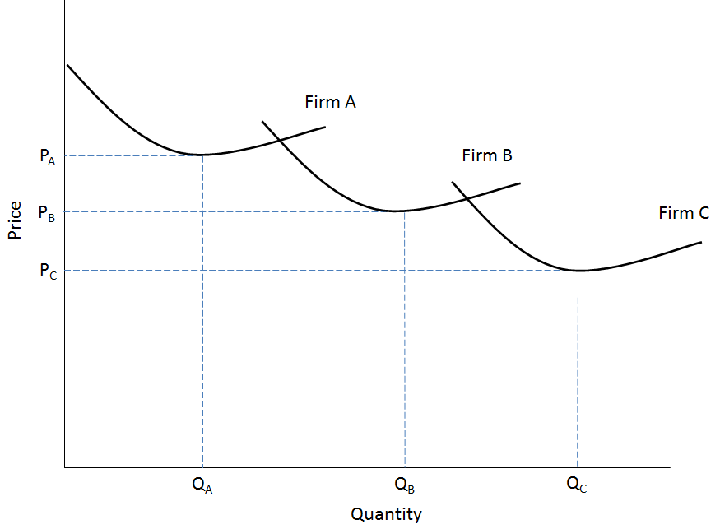
Traditional Regulation
Utility Natural Monopoly Conditions
Natural monopolies have large “economies of scale” which means that a utility’s average costs tend to decrease as output expands.
This cost advantage allows utilities to squeeze out potential higher-cost competitors.
This cost advantage also means that the most efficient outcome for society is to let one, low-cost firm serve the entire market.
Utility Cost
The problem with only allowing one firm to serve the market is that the single firm becomes a monopolist that has the ability to charge unnecessarily high prices and limit how much it produces.
© LSU Center for Energy Studies 9

Slide 10
Traditional Regulation
Center for Energy Studies
What Would Happen if We Didn’t Regulate?
If we did not regulate utilities, they could price far higher than what would normally occur in a competitive market.
$
Monopolist’s price much higher than competitive industry price.
An unregulated utility will price as high as the market will allow (as defined by demand) – this is at the point where marginal cost equals marginal revenue – which means at the margin (or incrementally) the monopolist has extracted all the profit that is possible out of the market.
P_{m}
P_{C}
Supply = Marginal Cost
Demand
Quantity
Q_{m}
Marginal Revenue
© LSU Center for Energy Studies 10

Slide 11
Traditional Regulation
Traditional Regulation
Center for Energy Studies
The Natural Monopoly Problem: Setting Prices at Optimal Levels
If competitive industries set prices at marginal costs, why don’t we force utilities to simply price their services at marginal costs? Primarily, because they have a large amount of shorter run fixed costs that have to get recovered. If we priced at marginal costs, utilities would go bankrupt.
$
If we set prices to MC then they would be too low and not allow the utility the opportunity to earn return on and of their investment.
AC*
AC
Loss to Firm
P*
MC
D
Q*
Quantity
© LSU Center for Energy Studies 11

Slide 12
Traditional Regulation
Traditional Regulation
Center for Energy Studies
Comparison of Various Monopoly/Regulated Pricing Outcomes
Regulators, therefore, have to choose prices that reflect some middle ground that give utilities a “fair-return” for their investments. This results in prices lower than what would occur under an unregulated monopoly, but higher than those arising in competitive markets.
$
Monopoly
Price
P_{m}
Fair Return
Price
Price and costs
P_{f}
ATC
P_{r}
MC
Socially
Optimal Price
D
MR
Q_{m}
Q_{f}
Q_{r}
Quantity
© LSU Center for Energy Studies 12

Slide 13
Monopoly
Traditional Regulation
Traditional Regulation
Why Regulation?
At the turn 20th century, many industrialized nations did not adopt a system of utility regulation, but instead “nationalized” their utility industries. The state owned these industries and operated them in the public interest. (i.e., British Gas, Gaz de France, National Grid, Scottish Power, Deutsche Telecom)
Utility regulation in the U.S. started out as a unique means of maximizing utility industry development and efficiencies, and reconciling the utility industry’s natural monopoly structure to the American system of private capital ownership.
However, U.S. utility regulation is not just a process of governing rates and services. The process is often said to be one that attempts to emulate competitive market forces, or serve as a “proxy for competition,” in order to maximize potential investment and operating efficiencies.
© LSU Center for Energy Studies 13

Slide 14
Monopoly
Traditional Regulation
Traditional Regulation
The Relationship Between Regulation and Competition
Traditional regulation limits the degree, nature, and timing of price changes much like competitive markets.
For instance, competitive firms cannot increase market prices, and if they increase their own prices unilaterally, without any industry-wide cost justification (like input cost inflation), they will likely lose market share and profits.
In addition, competitive firms that invest in innovative technologies that reduce costs and/or efficiently expand their abilities to increase the scope of their services, can increase market share and profitability.
Traditional regulation can facilitate similar competitive market outcomes through the timing of rate changes (rate cases) and what is known as “regulatory lag.”
© LSU Center for Energy Studies 14

Slide 15
Traditional Regulation
Center for Energy Studies
Regulatory Lag and a Form of Market Discipline
Regulatory lag is the period of time between when a utility’s rates go into effect and its next rate case and is an important means by which traditional regulation is thought to inject discipline upon utilities similar to that arising in competitive markets.
Under traditional regulation, rates are set on a utility’s prudently-incurred costs:
If a utility improves its operating/investment efficiencies after a rate case, then the increased profits associated with these actions accrue to the utility much like they would in a competitive market.
The inverse occurs if a utility becomes less efficient or is unable to contain its costs after a rate case: profits will fall much like they would in a competitive market.
© LSU Center for Energy Studies

Slide 16
Traditional Regulation
Center for Energy Studies
Historic Utility Earnings Compared to Estimated Allowed ROE for Industry Overall
Historically, electric utilities (on an industry average), have seen periods where they have clearly benefited from regulatory lag. The 2009-2010 recession, however, challenged achieved utility earnings relative to those allowed by regulators.
(Percent)
Utility industry average earnings above allowed returns (green line).
Recession-induced earnings decreases.
Note: Estimated achieved return is calculated as Net Income divided by Proprietary Stock (less preferred stock).
Source: Federal Energy Regulatory Commission; and Public Utilities Fortnightly.
© LSU Center for Energy Studies

Slide 17
Traditional Regulation
Center for Energy Studies
Regulatory Lag and Risk
Thus, regulatory lag is only “bad” for inefficient utilities. Some utilities have found regulatory lag beneficial and have not filed a traditional rate case for time periods that span anywhere from 7 to 15 years.
Regulatory lag, however, can increase utility earnings risk since future market conditions, weather, and the opportunities for innovation are not known with 100 percent certainty: but this is also true for many other energy industries, particularly those operating in competitive markets.
Further, utilities get a fair (i.e., market-based) rate of return to compensate for operating in markets with these types of rates.
Thus, utilities are compensated in two ways for this risk: (1) they are given an allowed rate of return that factors in these market risks and conditions and (2) have the opportunity to achieve some degree of additional earnings through regulatory lag (assuming they manage that lag successfully).
© LSU Center for Energy Studies

Slide 18
Center for Energy Studies
Alternative Regulation
© LSU Center for Energy Studies

Slide 19
Alternative Regulation
Center for Energy Studies
Asymmetric Information
What is Alternative Regulation?
Alternative regulation is a means of regulating utilities that relies less on a traditional rate case structure and more on an annual formulaic-based approach of setting rates.
Alternative regulation modifies traditional regulation: it does not replace traditional regulation. Alternative regulation focuses more on output and performance rather than inputs (measuring the cost of service in any given year).
Rationales for the use of alternative regulation:
      “Institutionalize” regulatory lag.
      Reduce asymmetric information problems.
      Reduce administrative costs.
© LSU Center for Energy Studies

Slide 20
Alternative Regulation
Center for Energy Studies
Asymmetric Information
How Does Alternative Regulation “Institutionalize” Regulatory Lag?
Regulatory lag gives efficient utilities the opportunity to increase their achieved earnings after a rate case.
These efficiency-induced excess earnings, however, are limited. In theory, under traditional regulation, a regulator can force a utility to decrease its rates if it finds earnings to be “excessive.” The ambiguity in what constitutes excessive earnings can discourage utilities from pursuing additional efficiency measures.
Alternative regulation attempts to release this excess earnings boundary (and ambiguity) through the use of pre-defined sharing bands and percentages with ratepayers. Future changes in rates, under an alternative regulation plan, are defined by utility performance and its ability to maximize the efficiency opportunities created by regulatory lag.
In this way, alternative regulation “institutionalizes” or formally “codifies” regulatory lag. This is another reason why alternative regulation is often called “performance-based regulation.”
© LSU Center for Energy Studies

Slide 21
Alternative Regulation
Center for Energy Studies
Asymmetric Information
Definition: Asymmetric Information
What do we mean by “asymmetric information?”
Definition: when one contracting party has a different set of relevant information relative to another contracting party it can lead to an inefficient outcome.
Pervasive problem in all forms of regulation (utility, environmental, financial, etc.) that regulators typically have less information about a regulated company’s operations and costs than the regulated company itself.
Informational asymmetries can result in “gold-plating” of capital investments and expenses (i.e. cost-inefficiencies). Since cost-of-service regulation is based upon costs, this can lead to inefficient rates.
Alternative regulation is thought to reduce the regulatory problems of asymmetrical information since (1) the regulatory emphasis shifts from inputs to outputs and (2) utilities have active rather than passive profit-maximization incentives.
© LSU Center for Energy Studies

Slide 22
Alternative Regulation
Center for Energy Studies
Asymmetric Information
How Does Alternative Regulation Reduce Administrative Costs?
Most alternative regulation methods use a formula or pre-defined approach to setting rates on a periodic basis.
This formula is typically set for a fixed number of years which can be anywhere from between 3-5 years.
No rate cases are usually allowed during the alternative regulation program time period. Rate cases are not, however, prohibited.
Rates only change by the formula or guidelines.
Avoiding rate cases is thought to reduce administrative costs of repeated rate cases although there are annual reviews of costs by regulatory staff during the alternative regulation program period.
Specific alternative regulation plan structure really determines whether or not administrative costs are actually reduced.
© LSU Center for Energy Studies

Slide 23
Alternative Regulation
Center for Energy Studies
Asymmetric Information
Alternative Regulation: Theory v. Practice
Alternative regulation has several theoretical appeals. However, the biggest challenge in program design is in appropriately assigning risks and rewards of the alternative regulation plan.
Conceptually, risks can be borne by either party (ratepayer, utility) provided they are corresponding opportunities for rewards.
All to often, program performance risks are shifted entirely on ratepayers, with few to little rewards.
Few states have an alternative regulation plan like Vermont. California is the only other state with an active alternative regulation plan comparable to Vermont.
© LSU Center for Energy Studies

Slide 24
Risks & Rewards
Center for Energy Studies
Alternative Regulation:
Program Design, Risks, and Rewards
© LSU Center for Energy Studies

Slide 25
Risks & Rewards
Center for Energy Studies
Incentives & Performance
Primary Components of an Alternative Regulation Plan
Alternative regulation plan should be based upon a structure that balances risk and rewards between ratepayers and utilities. These plans are typically based upon three primary components
Formulas that defines how annual rate changes will be allowed to occur. This also includes a definition of the costs eligible for annual increases.
Formula for allowed annual rate change
This mechanism defines how excess earnings, or under-earnings, will be shared between ratepayers and utilities. This can be thought of as the “profit-sharing” aspect of the plan that occurs after the fact.
Earnings sharing mechanism
Program duration
The program duration defines the time period under which utilities will be subjected to the plan and the time period in which formal rate cases are not allowed.
© LSU Center for Energy Studies

Slide 26
Risks & Rewards
Center for Energy Studies
Incentives & Performance
Alternative Regulation: Framework for Allowed Rate Changes
Alternative regulation plans allow revenues/prices to grow by a pre-defined formula during the program duration.
Traditional formula:
Allowed Revenue (or Price) Increase =
(Change in Inflation) less (Productivity Offset) plus (“Exogenous” Factor)
Revenues/prices allowed to increase by the rate of inflation as measured by standard government indices like the CPI.
Revenues/prices are reduced by a fixed measure of industry productivity. This adjustment forces some cost discipline on utility since it reduces the magnitude of the overall inflation adjustment.
Utilities are often allowed to increase revenues/prices for unexpected (“exogenous”) changes in costs like unexpected tax changes or costs associated with severe weather events.
Trade-offs: A low productivity offset, and a generous exogenous factor adjustment, will reduce utility risk by providing for a relatively stable, undiscounted increase in rates. High productivity offsets and narrow exogenous adjustment allowances will tend to reduce risks for ratepayers.
© LSU Center for Energy Studies

Slide 27
Risks & Rewards
Center for Energy Studies
Incentives & Performance
Alternative Regulation: Why Allow Rate Changes Without a Rate Case?
Rates, Costs
Annual rate changes allowed under alternative regulation is thought to facilitate a utility’s ability to continue to invest in its system and to explore cost efficiency opportunities including cost efficiency investments such as automation and equipment upgrades.
Rates (Alt Reg)
Costs
1
2
3
4
5
Time Period
The regulatory emphasis on determining the potential cost of service is reduced in favor or monitoring performance outcomes. Utilities are allowed to increase rates and must live within the means allowed by the price change formula. Alternative regulation was originally developed to facilitate capital investment by allowing rates to change without rate cases. This approach differs from “trackers” which allow explicit costs to be flowed-through rates on a dollar-for-dollar basis.
© LSU Center for Energy Studies

Slide 28
Risks & Rewards
Center for Energy Studies
Incentives & Performance
Alternative Regulation: Productivity Offsets (Illustration)
Rates, Costs
Time Period | Inflation Increase (%) | Productivity Offset (%) | Net Allowed Rate Change (%)
1 | 3.0% | 1.0% | 2.0%
2 | 2.8% | 1.0% | 1.8%
3 | 4.2% | 1.0% | 3.2%
4 | 2.5% | 1.0% | 1.5%
5 | 3.0% | 1.0% | 2.0%
Rates (inflation only)
Rates (inflation less productivity offset)
Costs
1
2
3
4
5
Time Period
The productivity offset works to adjust allowed inflation increase. The offset is fixed (does not vary like inflation) to account for industry-wide productivity that would normally be passed along to customers if the industry were competitive. The larger the productivity offset, the smaller the allowed annual rate change (holding inflation constant).
© LSU Center for Energy Studies

Slide 29
Risks & Rewards
Center for Energy Studies
Incentives & Performance
Alternative Regulation: Exogenous Shocks
Most alternative regulation plans recognize the possibility that “outside” (exogenous) factors can influence utility costs like an unexpected change in taxes or the costs of unexpected weather events.
Exogenous adjustments in most alternative regulation plans are designed to address changes in costs that are infrequent in nature and associated with events outside utility control.
Exogenous adjustments should not be used to facilitate cost recovery for known and measureable costs (like new asset development) that are entirely within a utility’s control or large enough to justify a traditional rate case. Unfortunately, both Vermont alternative regulation plans allow rates to be increased for exactly these kind of known and controllable costs.
Passing through large, known costs within a utility’s control, and with little active regulatory oversight, incorporates one of the worst aspects of cost-plus regulation into alternative regulation.
© LSU Center for Energy Studies

Slide 30
Risks & Rewards
Center for Energy Studies
Incentives & Performance
Alternative Regulation: Risks & Earnings Sharing Mechanisms -- Bands
A large number of narrow sharing bands creates more graduated opportunities for sharing. Broad bands reduce those opportunities – increased sharing opportunities will require exceptionally large excess earnings.
ROE
ROE
Narrow, graduated bands give both parties more earnings sharing opportunities
ROE_{A} + 100 basis points
Large dead-band would require large earnings, in excess of 100 basis points (bps) of the allowed ROE, in order for ratepayers to share in any efficiency benefits.
ROE_{A}
ROE_{A}
1
2
3
4
5
Time/Period
1
2
3
4
5
Time/Period
© LSU Center for Energy Studies

Slide 31
Risks & Rewards
Center for Energy Studies
Incentives & Performance
Alternative Regulation: Risks & Earnings Sharing Mechanisms – Sharing Percentages
Increasing sharing percentages require utilities to work harder in order to share in excess earnings whereas a declining sharing percentage scale gives utilities first claim to excess earnings.
100%
100%
75%
75%
50%
50%
Decreasing sharing scale (utility)
Increasing sharing scale (utility)
25%
25%
0 -25 bps
25 -50 bps
50 -100 bps
> 100 bps
0 -25 bps
25 -50 bps
50 -100 bps
> 100 bps
Sharing Band
= ratepayer share
Sharing Band
= utility share
© LSU Center for Energy Studies

Slide 32
Risks & Rewards
Center for Energy Studies
Incentives & Performance
Alternative Regulation: Risks & Program Durations
Alternative regulation plans are commonly set in three to five year range, although some are set for much longer periods that can include up to one decade.
Length is often part of the regulatory bargain between utilities and regulators and likely determinant on other program components (like earnings sharing bands).
Longer stay-out periods are thought to give utilities the opportunity for making longer-run investments that will yield efficiency gains (and returns) over a period of time. Longer stay out periods help to create opportunity to attain the full return from the investments.
Shorter stay-out periods, however, can help to reduce any long periods of time unanticipated disconnects that can arise between rates and costs without rate recalibration.
© LSU Center for Energy Studies

Slide 33
Risks & Rewards
Center for Energy Studies
Incentives & Performance
Summary of Alternative Regulation Design Characteristics - Risks
© LSU Center for Energy Studies

Slide 34
Center for Energy Studies
Critique of Vermont Alternative Regulation:
Opportunities for Design Improvement
© LSU Center for Energy Studies

Slide 35
Vermont Alt Regulation
Center for Energy Studies
Incentives & Performance
Current Vermont Approach
Vermont alternative regulation programs for Vermont Gas Systems (“VGS”) and Green Mountain Power (“GMP”) have a number of major features that are similar to other alternative regulation methods including:
Fixed program duration periods with sunsets.
Formula-based base rate increases.
Earnings sharing mechanisms.
Program experience to date, however, has led to few ratepayer benefits. Program design issues have tipped the scales of the current mechanism more in favor of shareholders rather than ratepayers.
© LSU Center for Energy Studies

Slide 36
Vermont Alt Regulation
Center for Energy Studies
Incentives & Performance
Vermont Alternative Regulation: Major Program Deficiencies
Vermont experience, to date, underscores the proverbial “devil in the details” problems with regulatory policy design. The issue with Vermont’s alternative regulation programs rests with how alternative regulation has been constructed, and modified, since 2006.
The three primary Vermont alternative regulation design deficiencies include:
The trade-offs between annual base rate increases and the ESM is skewed, and primarily benefits shareholders, not ratepayers.
Recent modifications to both alternative regulation plans (VGS, GMP) have shifted a considerable degree of uncompensated risk away from the utilities and to ratepayers. This is particularly true for VGS.
The provisions for “exclusions” included in both alternative regulation plans are based upon a questionable premise (that capital expenditures cannot be accommodated). This combines the worst of “cost-based regulation” and alternative regulation.
© LSU Center for Energy Studies

Slide 37
Vermont Alt Regulation
Center for Energy Studies
Incentives & Performance
Earnings Sharing Experience To Date (Green Mountain Power)
To date, ratepayers have received a total of over $800,000 from the sharing portion of the GMP alternative regulation plan. GMP’s shareholders, however, have received close to $7.0 million.
© LSU Center for Energy Studies

Slide 38
Vermont Alt Regulation
Center for Energy Studies
Incentives & Performance
Recently-Adopted Provisions Shifting Risk to Ratepayers
Recent modifications to both the VGS and GMP plans shift risks away from utility shareholders and onto ratepayers. Examples of these risk shifting provisions include:
Return on equity (ROE) is now indexed to market rates.
Historically, and under traditional regulation, the allowed ROE is fixed. Now allowed ROEs are variable and move with market conditions which can be both favorable and unfavorable. This makes base rate adjustments more variable.
Traditionally, utility earnings vary based upon general economic conditions. Utilities bear the risk of changes in weather and the economy. This modification eliminates one component of earnings variation.
ESM calculated on weather normalization basis (VGS only).
Gas cost sharing mechanisms eliminated (VGS only).
Reduction of power adjustor efficiency band (GMP only).
Both provisions were originally adopted to require some “buy-in” from each utility in terms of their off-system gas and power purchases. This “buy-in” has been substantially reduced.
Creation of SERF that permanently “expropriates” prior ratepayer alternative regulation benefits.
The SERF diverted approximately $4.4 million in what should have been commodity gas-related savings (PGA) to a new fund designed to cover the investment costs of new infrastructure investments. This action effectively expropriated ratepayer savings and creates regulatory risk regarding whether future ratepayer savings will also be skimmed.
© LSU Center for Energy Studies

Slide 39
Vermont Alt Regulation
Center for Energy Studies
Incentives & Performance
Provisions for “Exclusion” Costs
Both plans (GMP, VGS) have provisions that allow for the recovery of certain annual capital investments. These types of costs are referred to as “exclusionary” in the VGS plan and include items that impact utility costs and are under utility control.
These costs are allowed because it is believed that in doing so the Board will be removing an incentive to avoid costs that would otherwise be desirable. In other words, under the belief that alternative regulation will incent utilities to not make investments needed to provide safe, economic and reliable service. This should not be the case and the premise is inconsistent with the origins of alternative regulation.
Price increases allowed under alternative regulation are made to facilitate utility investments, much like those which would arise in competitive markets. Competitive firms, for instance, must facilitate their own capital investments through annual price increases, efficiencies, and the cost-effectiveness of the investment. Competitive firms don’t get “pass-through” trackers for capital investments.
© LSU Center for Energy Studies

Slide 40
Vermont Alt Regulation
Center for Energy Studies
Incentives & Performance
Relationship Between ARP “Exclusions” and Trackers
The use of exclusions in the Vermont ARP creates a cost-plus based mechanism (or “pass-through” mechanism or “tracker”) that directly incorporates costs into annual rate adjustments on a dollar-for-dollar basis.
Trackers run counter to the two primary goals of alternative regulation: (1) creating greater operating efficiencies and (2) reducing regulatory/administrative costs.
Cost plus mechanisms reduce the beneficial aspects of regulatory lag that disciplines utility decision making and efficiency incentives.
Regulatory/administrative costs are increased since the costs associated with these mechanisms need to be reviewed annually (and more quickly). Makes the process more difficult for stakeholder group participation.
© LSU Center for Energy Studies

Slide 41
Vermont Alt Regulation
Center for Energy Studies
Incentives & Performance
Exclusions and Ratepayer Protections
These exclusions are even more problematic since they do not include ratepayer protection mechanisms that are often utilized with cost trackers in other states such as:
  Term/cap/sunset provision.
  Rate Impact cap.
  Deferrals/Carrying charge limitations.
  Risk-Adjusted ROEs.
  Performance Benchmarks.
  Detailed Annual Minimum Filing requirements.
The recent GMP successor plan did, however, include a number of new annual minimum filing requirements that should assist in the annual regulatory review of these types of investments.
© LSU Center for Energy Studies

Slide 42
New Natural Gas End Uses & Fuel Diversity Concerns
Ratepayer Advocacy
© LSU Center for Energy Studies

Slide 43
Ratepayer Advocacy
Why is Ratepayer Advocacy Important?
New Natural Gas End Uses & Fuel Diversity Concerns
Ratepayer advocacy is important because it provides official sanction and resources for the express purpose of representing the collective interests of ratepayers that typically do not have the collective organization, resources, or information to advocate individually before regulatory commissions.
Utilities often have considerable resources to adequately advocate for their interests on both an individual and collective basis.
Industrial and large commercial groups typically have trade associations to represent their interests.
Residential and small commercial customers typically fall into this under-represented category.
© LSU Center for Energy Studies

Slide 44
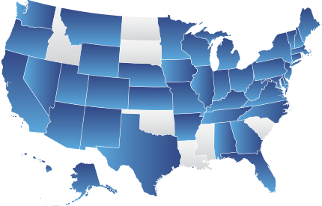
Ratepayer Advocacy
U.S. Offices of Ratepayer Advocacy
New Natural Gas End Uses & Fuel Diversity Concerns
There are currently 40 different legislatively-created ratepayer advocacy offices in the U.S.
Source: National Association of State Utility Consumer Advocates (“NASUCA”).
© LSU Center for Energy Studies

Slide 45
Ratepayer Advocacy
What is a Ratepayer Advocate?
New Natural Gas End Uses & Fuel Diversity Concerns
Ratepayer advocates are usually statutorily-created offices designed to represent and advocate for ratepayer interests.
In some states, this advocacy is defined broadly across all customer classes. In some instances the legislatively-set advocacy mission is limited to just residential and small commercial customers.
A ratepayer advocate’s mission should be as an active and independent advocate and representative for ratepayers taking positions that directly support economic, safe and reliable service.
Ratepayer advocacy does not translate into unbridled litigation nor does it suggest consistent opposition to utility and stakeholder positions. It does mean strong, independent, and transparent representation.
© LSU Center for Energy Studies

Slide 46
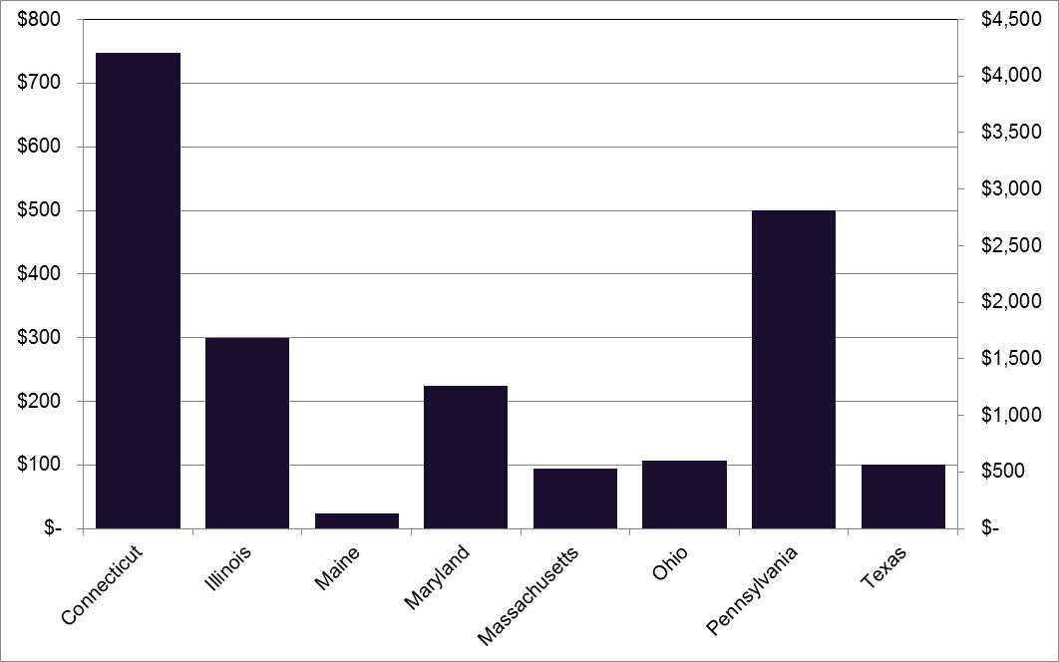
Ratepayer Advocacy
Selected Performance of Ratepayer Advocacy Offices
New Natural Gas End Uses & Fuel Diversity Concerns
Most major Ratepayer Advocate offices are estimated to provide ratepayer benefits that are multiples of their respective annual budgets. California (not pictured) reports saving over $4.2 billion in 2012 alone.
Annual Savings ($ Millions)
© LSU Center for Energy Studies

Slide 47
Ratepayer Advocacy
How is the Independence of Ratepayer Advocacy Ensured?
New Natural Gas End Uses & Fuel Diversity Concerns
Organization: optimally, ratepayer advocates should be an independent office or agency that is removed from the regulatory commission’s structure and oversight. Many state ratepayer advocates are either independent offices that answer to the Governor or Legislature, or part of the Office of the Attorney General.
Funding: ratepayer advocates should have independent financial resources to litigate effectively in a regulatory proceeding. These funds can come a direct draw on regulatory assessments (as approved by other state administrative agency or legislative office) or covered directly from utilities (for fixed amount) on a proceeding-by-proceeding basis.
Selected Individual: a large part of a successful ratepayer advocate rests with the individual selected for the job. Ratepayer advocates should have technical and/or legal expertise and should have strong track record for independent action and advocacy. Individual should (optimally) have limited direct ties with commission and utilities.
© LSU Center for Energy Studies

Slide 48
Ratepayer Advocacy
Differences between a Ratepayer Advocate and Commission Staff
New Natural Gas End Uses & Fuel Diversity Concerns
A ratepayer advocate’s mission is (and should be) entirely different than a regulatory commission or regulatory commission’s staff.
The goal of regulatory commissioner should be to serve as a neutral arbiter of fact, balancing the interest of regulatory stakeholders.
The mission of a commission staff should be to ensure that the regulatory commission has adequate information to make decisions: the commission staff should not be an active advocate for any party.
Commission staffs should only actively provide testimony in a regulatory proceeding in those instances where the evidentiary record is known to be incomplete.
Commissions staffs should be professional advisors and experts, not advocates.
© LSU Center for Energy Studies

Slide 49
New Natural Gas End Uses & Fuel Diversity Concerns
Conclusions & Recommendations
© LSU Center for Energy Studies

Slide 50
Conclusions
Conclusions
Regulatory lag is not “bad” and is the primary incentive mechanism included in regulation that should increase utility efficiency incentives in a manner similar to competitive markets (efficiency leads to increased profitability).
Alternative regulation is a modification of, not a substitute for, traditional regulation by taking a little of the “old” (cost of service ratemaking and regulatory lag) and combining this with a little of the “new” (formulaic increases in rates and fixed regulatory review periods) to increase the effectiveness of the regulatory process for both parties (utilities and ratepayers).
Alternative regulation changes the regulatory emphasis from focusing on “inputs” (i.e., the cost of service) to one that emphasizes “outputs” (i.e., efficiency and profitability): this is why alternative regulation is often referred to as performance-based regulation, because its underlying goal is encourage efficient performance.
A good alternative regulation program ensures that the risks and rewards between ratepayers and utilities are balanced. The current Vermont alternative regulation plans do not do a good job at balancing risks and rewards but could be easily changed to ameliorate each of the programs’ shortcomings.
New Natural Gas End Uses & Fuel Diversity Concerns
© LSU Center for Energy Studies

Slide 51
Recommendations
Summary of Recommendations
Require the Board to open a proceeding to reconcile alternative regulation plans between VGS and GMP with the goal of creating program consistency that balances the risks between utilities and ratepayers.
Limit the use of capital expenditure cost recovery mechanisms within the plans:
  No capex mechanisms allowed until project-specific and financial need is proven.
  If major capital program costs are allowed, utilities must be required to provide a detailed set of minimum filing requirements for annual reconciliations (similar to the recent GMP settlement agreement).
  If major capital program costs are allowed, utilities must include performance-based measures with penalties for non-performance.
  If capital program costs are allowed, they must be subjected to ratepayer protection mechanisms that include, but are not limited to, total annual investment caps, rate impact caps, minimum filing requirements, and performance benchmarks with penalties for non-compliance.
Consider additional modifications to make the Department more consumer advocacy-oriented.
New Natural Gas End Uses & Fuel Diversity Concerns
© LSU Center for Energy Studies

